Slide 1
Dr.Nisha
Assistant professor
Dept:of practice of medicine

Slide 6
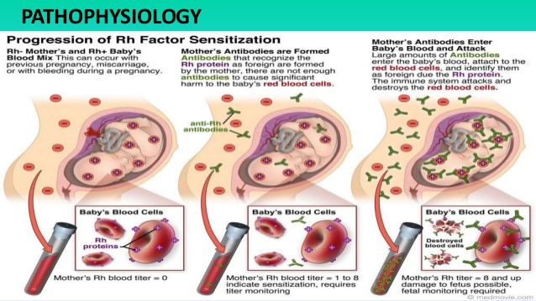

Slide 8
Hemolysis leads to the development of marrow hyperplasia and extramedullary hematopoiesis.
Hepatosplenomegaly occurs
Hepatic– hypofunction alters (albuminemia,ascites,and hydrops fetalis develops)
In the severe form ,there is congestive heart failure,impairment of placental circulation,intra uterine growth retardation and still birth.

Slide 9
The excess of bilirubin resulting from excessive hemolysis is handled both by the liver and placenta during fetal life.
But after birth,this bilirubin load has to be handled by the liver alone.
Unconjugated bilirubin crosses the blood brain barrier when the serum levels are high
It gets deposited in neural cells
It interferes with mitochondrial function and leads to cell death and permanent neurological defects.
(neurons in the brainstem,basal ganglia are affected )

Slide 10
BILIRUBIN NEUROTOXICITY
The unconjugated bilirubin formed by hemolysis is bound to albumin, but when the bilirubin level exceeds 20mg/dl,the binding capacity of albumin is exceeded and the unbound bilirubin passes to the CNS and causes damage, which is most affected in the basal ganglia.
The toxic effects of bilirubin on the neurons depend on the concentration of unconjugated bilirubin.bilirubin neurotoxicity is clinically characterized by;
Extrapyramidal movement disorders-dystonia,choreoathetosis or both
Hearing loss due to auditory neuropathy spectrum disorders.
Oculomotor paresis.

